Slide 1
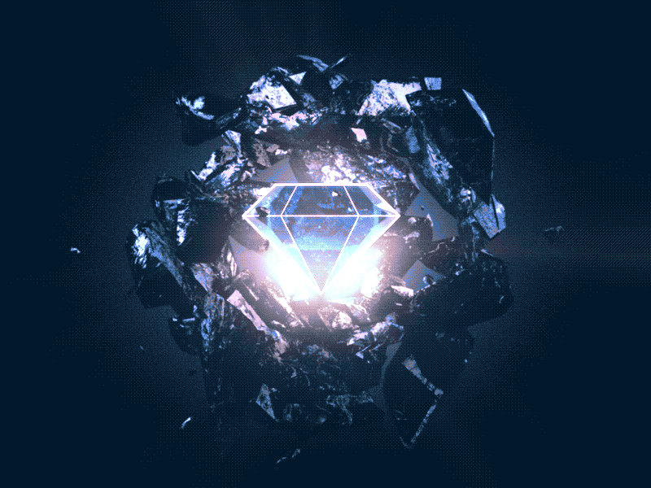
Xalmas - Ecosystem for Digital Asset backed by Diamonds
A project by:
Ali
Javier
Saiful
Omar
Abhilesh
Mohammad

Slide 2
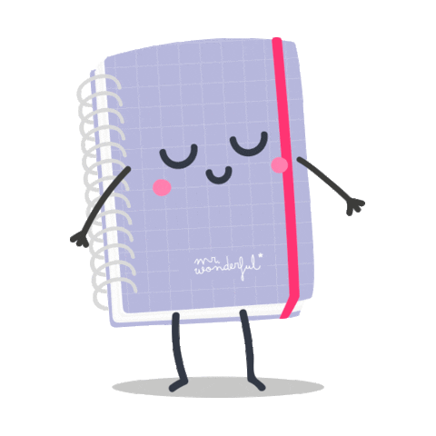
AGENDA
Xalmas Ecosystem & Dalmas Tokens
Xalmas Technical
Technical Architecture
Technology Stack
Deployment Plan

Slide 3
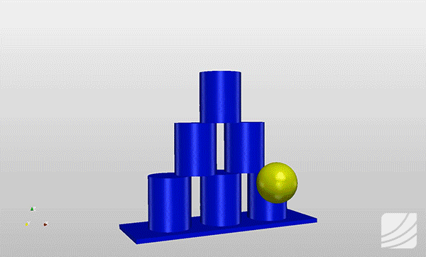
SUMMARY
Business Owner >>Elon Dumond, an international diamond trader
Looking for >>Expansion of Market
Market challenge>> more customers willing to pay high price
Business Proposal >> Start up a new business idea to attract more customers by offering certified and high-grade diamonds as an investment opportunity given the continuous value appreciation of diamonds, and by selling tokens that are backed by diamonds through the blockchain worldwide.
Why?? >>Diamonds are an ideal asset for backing a token since they are rare, take a billion years to develop, have several millennia of history as a recognized store of value, and are small and therefore easily stored and transported.
Initial Steps Taken >>>>
Elon has contacted the FT32 Consulting Group for developing the technology solution that will enable his business idea

Slide 4
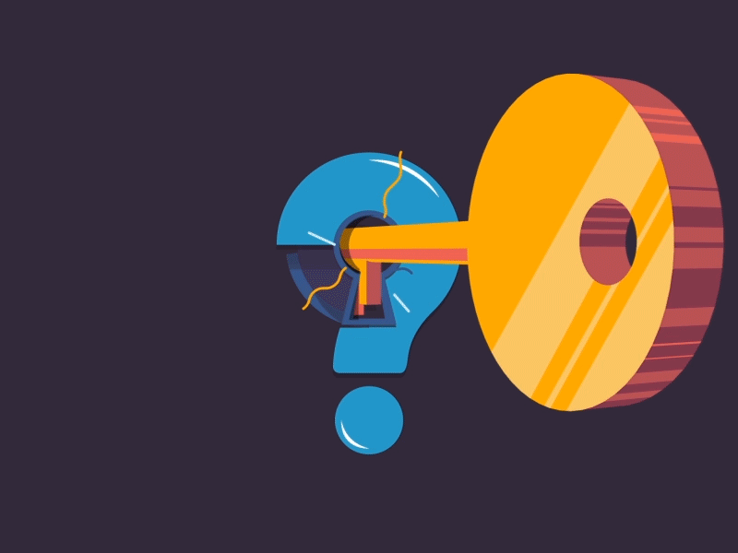
Problems & Solutions Identification:
Perceived Distrust - Customers are afraid of investing in a non-physical asset that is not secured or guaranteed by a bank or financial institution | The value of the Dalmas tokens will be backed by real Diamonds that will be stored in secured and insured vaults located in global locations offered by brokers. Each diamond will have an NFT registering the diamond as an asset attached to the Dalmas tokens, once an NFT is minted then the registered diamond becomes the property of the shareholders who own the pool of Diamonds. The Diamonds will have an NFT that registers the identification number engraved on the diamonds together with the accompanying Gemological Institute of America (GIA) certification of the quality of the diamond
Limited market - Very few investors would have a large capital to afford investing in high priced diamonds | A low dollar value of the Dalmas token will allow investors to afford investing with as low as a $10 USD. It will make this investment opportunity accessible to million of investors across the world
Reduced accessibility - High priced diamonds are locked or heavily secured and they are not easily accessible to customers | The Dalmas tokens will be accessible to any investor around the globe that has access to the internet. Dalmas tokens can be acquired from the Dalmas site, the transaction is completed directly in the blockchain without the intervention of any third party. Dalmas investors have access to the full information related to their investments.
Low Liquidity - The transaction of acquiring or selling a diamonds is complex and may require long time | Investors can get the refund for their tokens based on the updated token value; investors can exchange their Dalmas with other blockchain tokens via other platforms
Skepticism to new technology - Blockchain is a new technology with an steep learning curve for investors | The site for the Dalmas will provide a user friendly channel for investors to acquire and do transactions for the Dalmas Token without the frictions of learning about blockchain technology.

Slide 5
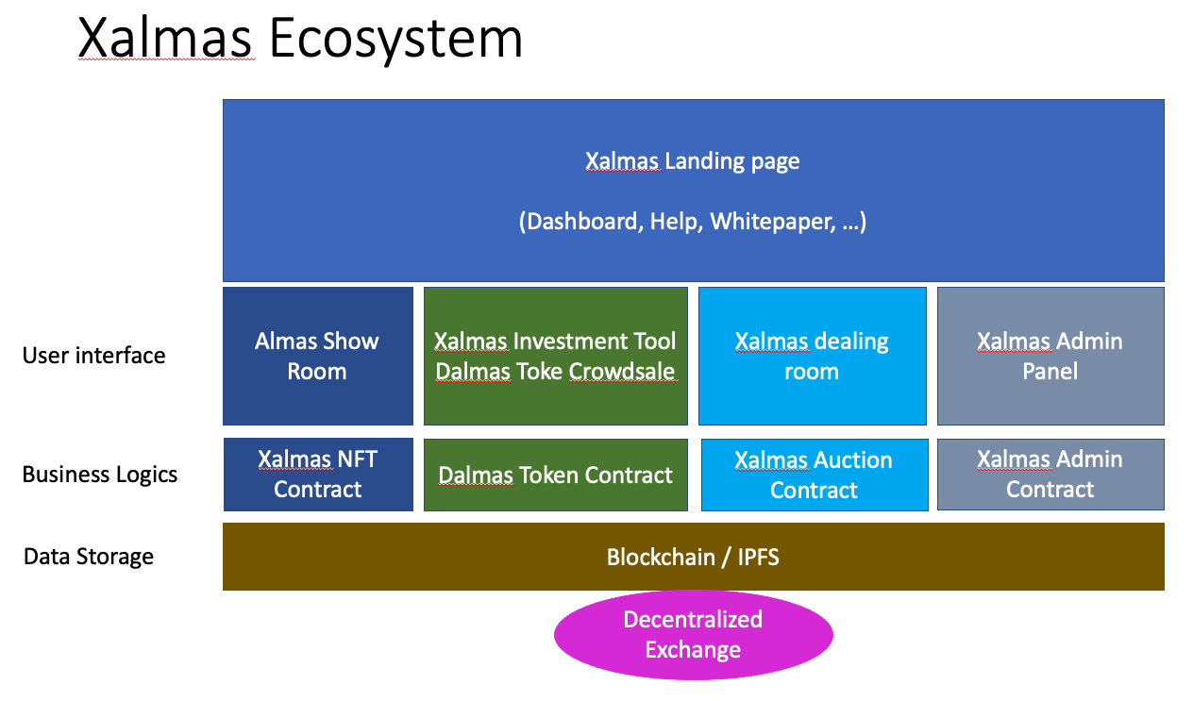
Ecosystem

Slide 6
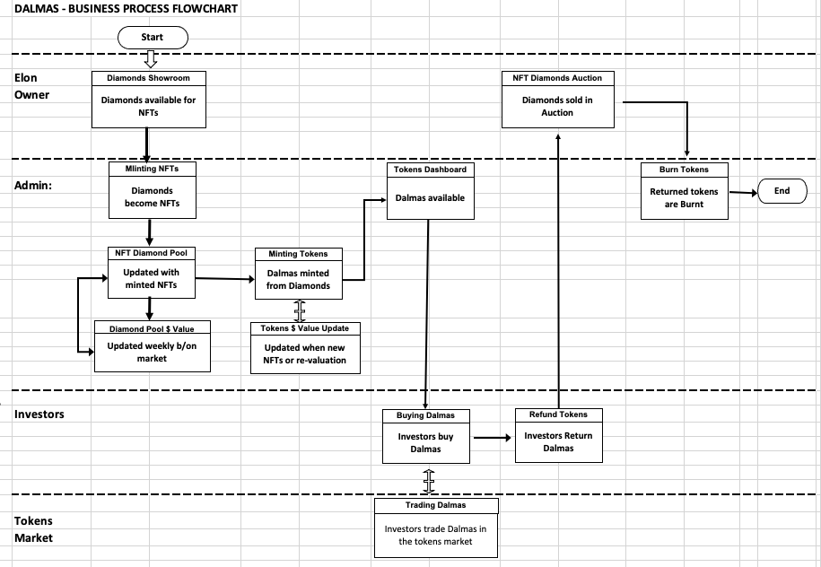
Dalmas business process flowchart

Slide 7
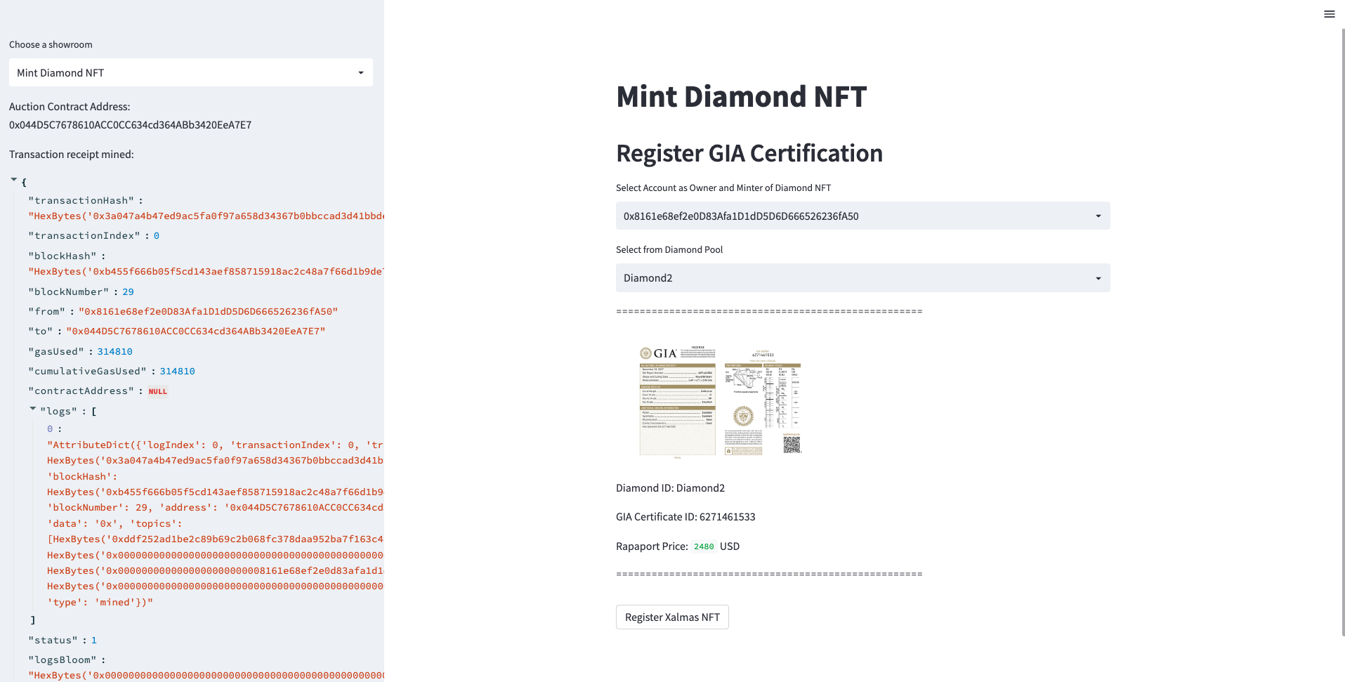
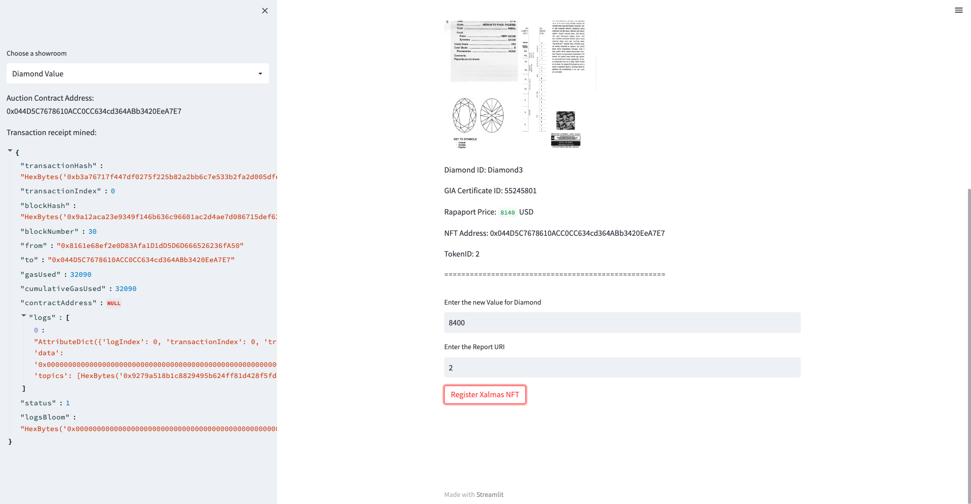
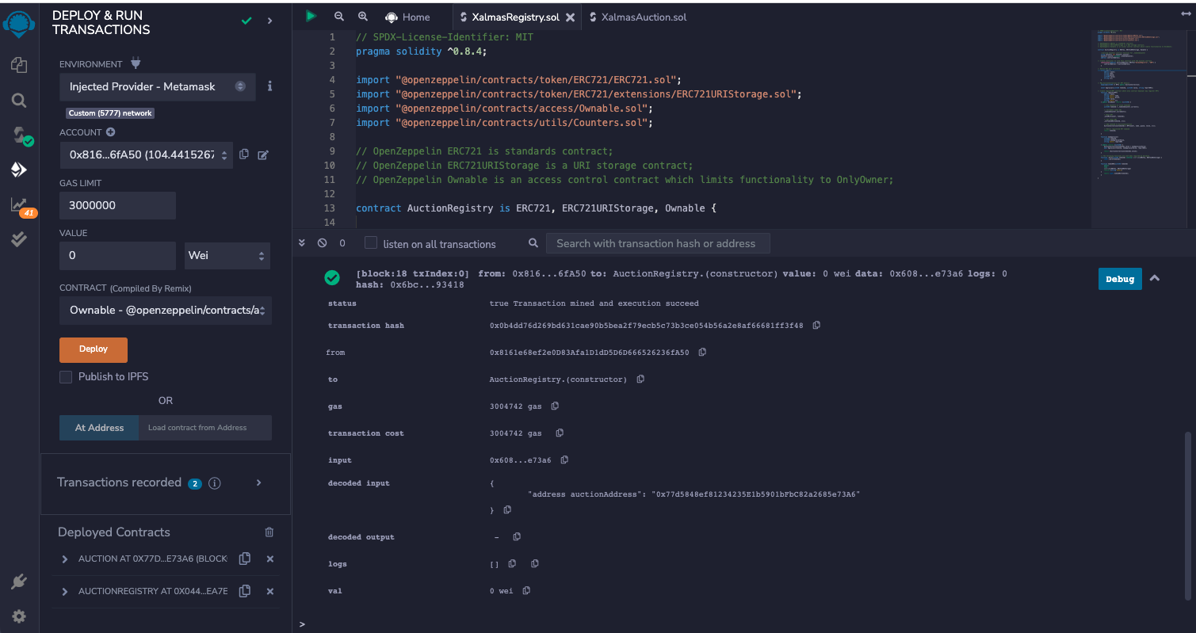
Xalmas NFT Contract
Xalmas Show Room It provides a list of the Diamonds and their relevant information; this application allows the minting of Diamonds and registration as as NFTs and the updates to the values of the Diamond

Slide 8
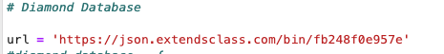
Xalmas NFT Contract
CODE HIGHLIGHTS
1. Created a dataset in JSON format and stored it on an API key to manipulate data.
2. Used json.loads to encode the data from the file and convert it into a python dictionary.
3. Defining functions

Slide 9
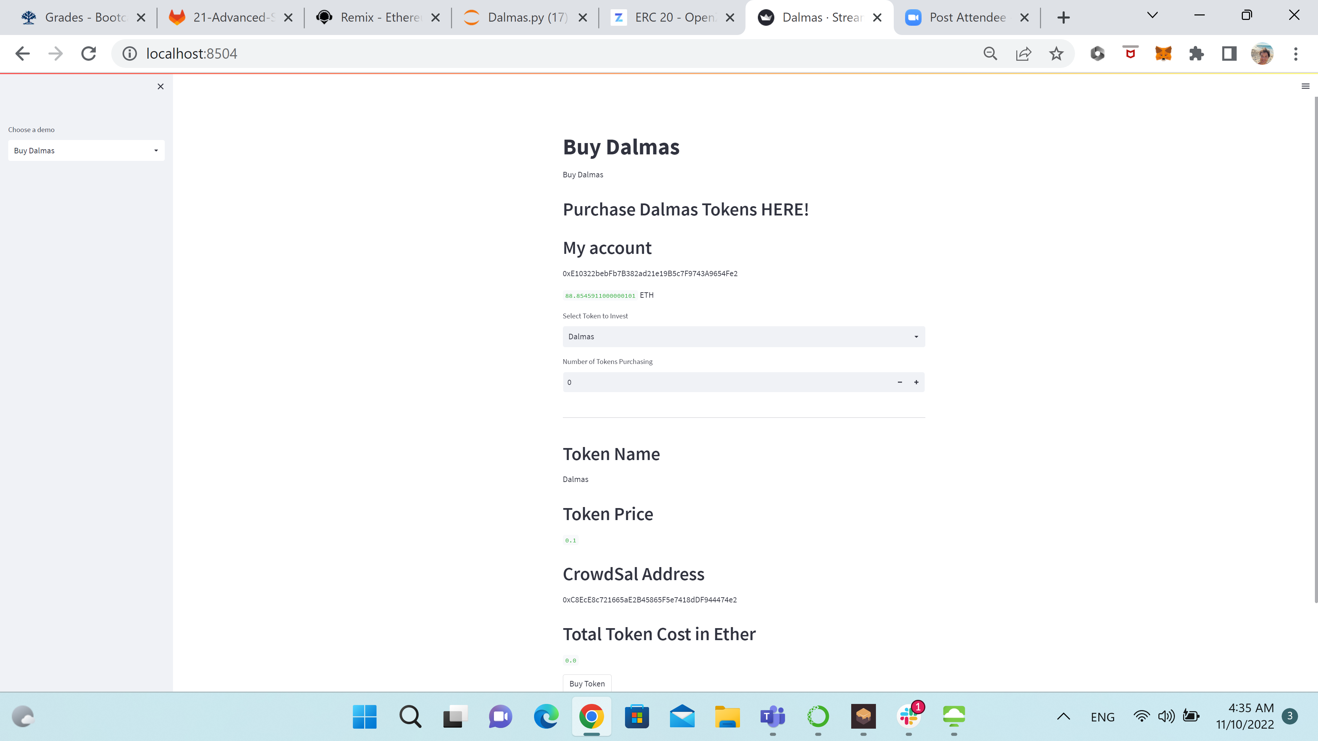
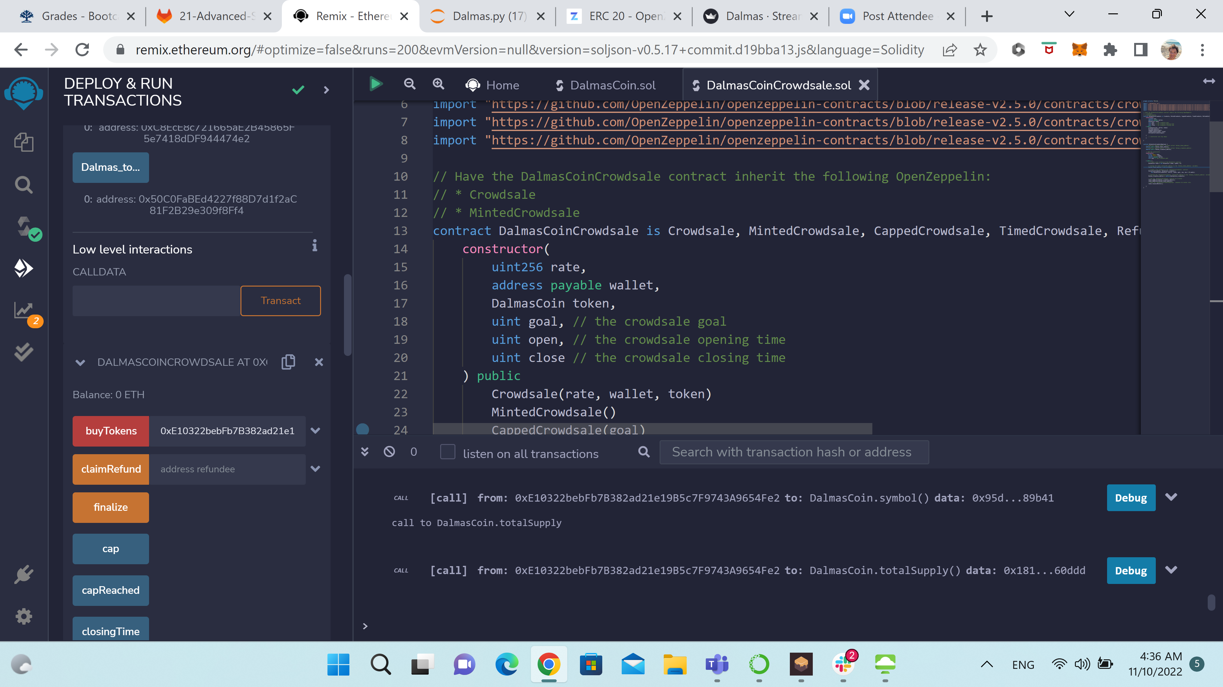
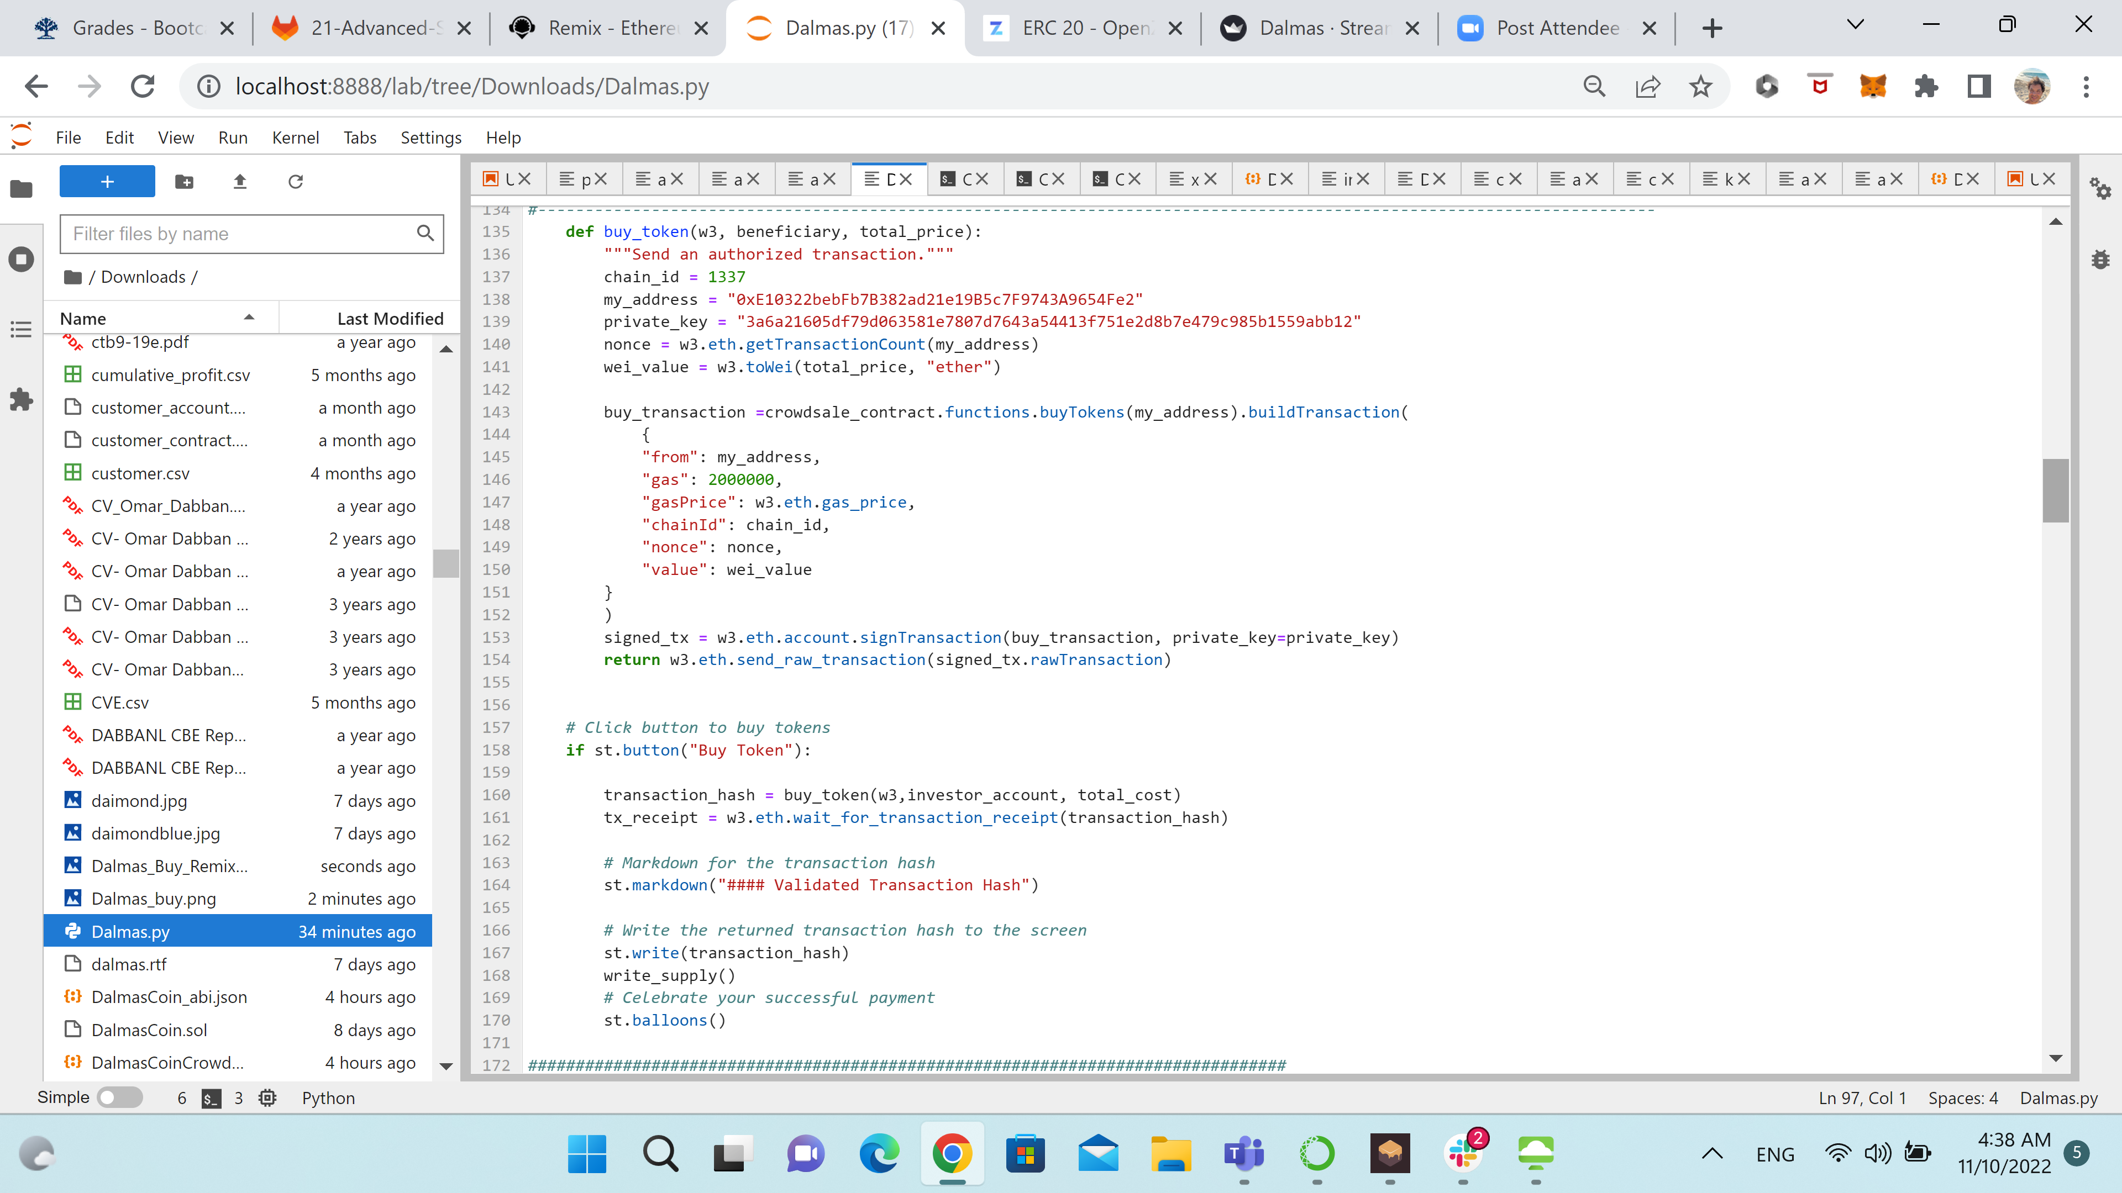
Dalmas Tokens Xalmas Investment Tool (Dalmas Token) This module provides the tools for investors to purchase or return tokens for refunds. It provides information about the total tokens and it allow ADMIN to burn tokens that were returned.

Slide 10
Xalmas auction contract
Xalmas Dealing Room This module allows the sale of Diamonds via auction to fetch the best value.

Slide 11
Xalmas admin contract & DEX
Xalmas Decentralized Exchange This application will lead to the exchange where Dalmas can be traded for other tokens in the blockchain market.

Slide 12
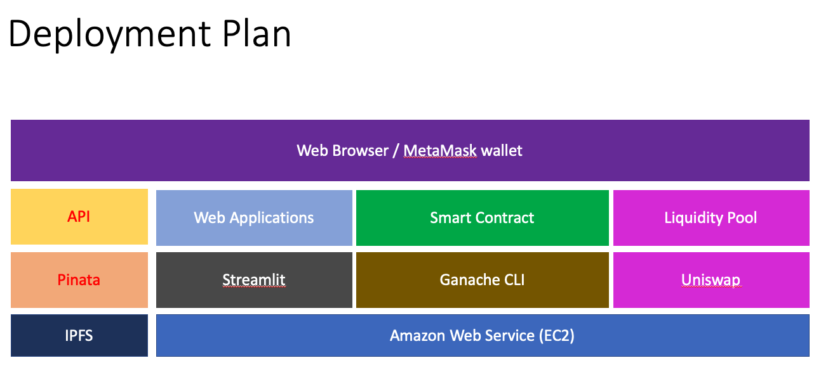

Slide 13
Xalmas & dalmas demonstration

Slide 14
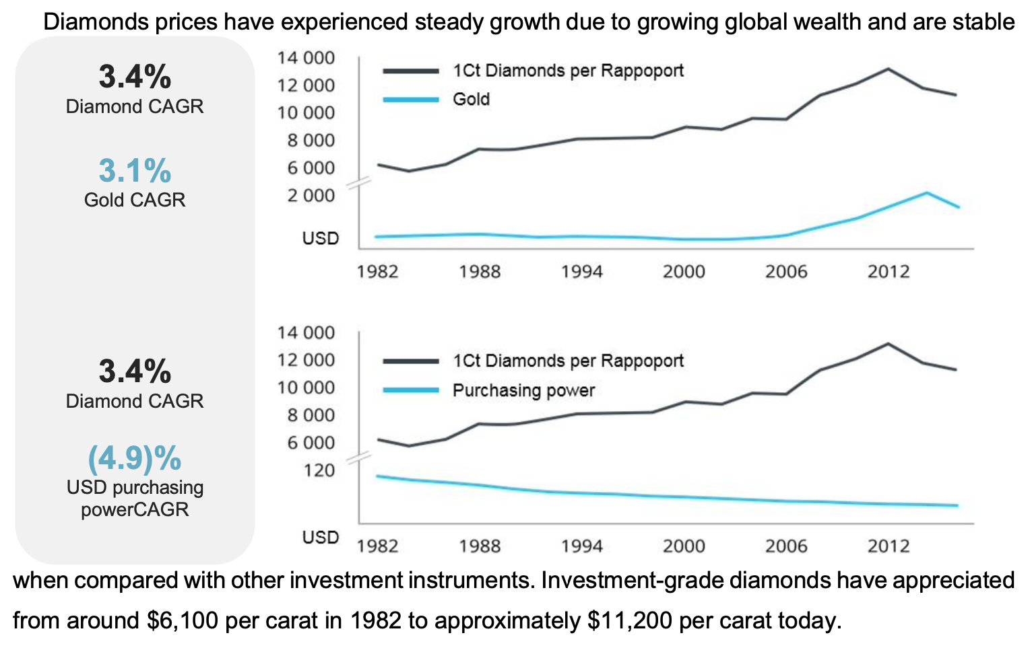
Appendix 1

Slide 15
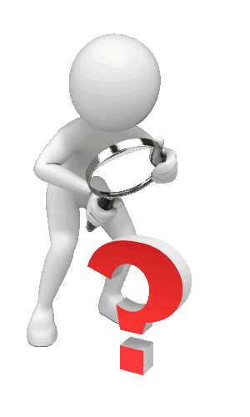

Slide 16


